Slide 1
A development of Compact Triple band Receiver for millimeter-wave radio astronomy
Korea Astronomy and Space Science Institute (KASI)
Seog-Tae Han and KVN receiver group
sthan@kasi.re.kr
8-11 October 2018, Granada, Spain

Slide 2
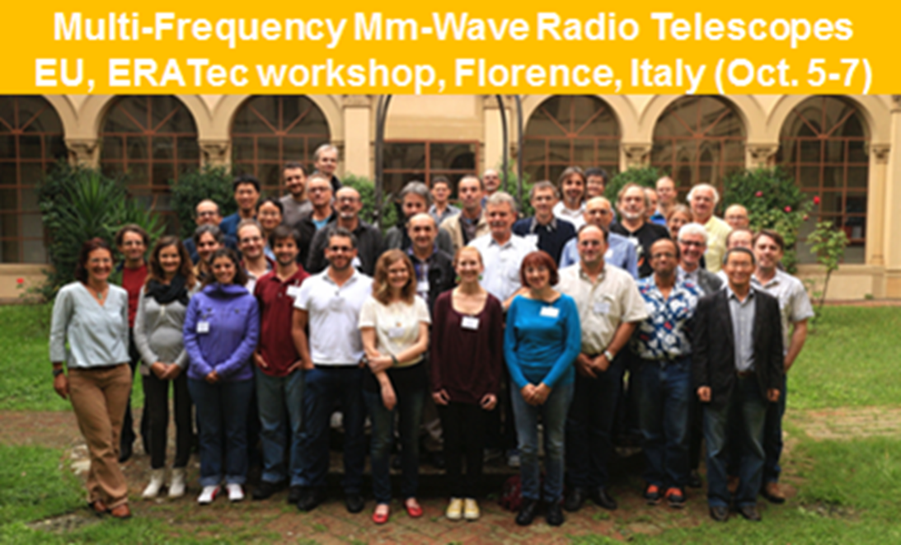
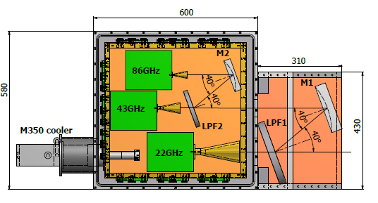
Motivation and Overview
The middle of April 2015 : Drs. Richard Dodson and Maria Rioja
* Why don’t you make “Compact Triple band receiver(CTR)” to be installed any radio telescope, Not like that of KVN
Oct. 5~7 2015 : ERA Tec workshop, Florence, Italy
* Proposed “ Conceptual design of CTR”
Sept. 20 , 2016 : 2016 EVN symposium, St. Petersburg, Russia
* Presented “ Development of Quasi-optical circuit for CTR”
Today(after 3 and half years) : 2018 EVN symposium, Granada, Spain
* Present “ Development and test observations results of CTR”
Conceptual design of CTR

Slide 3
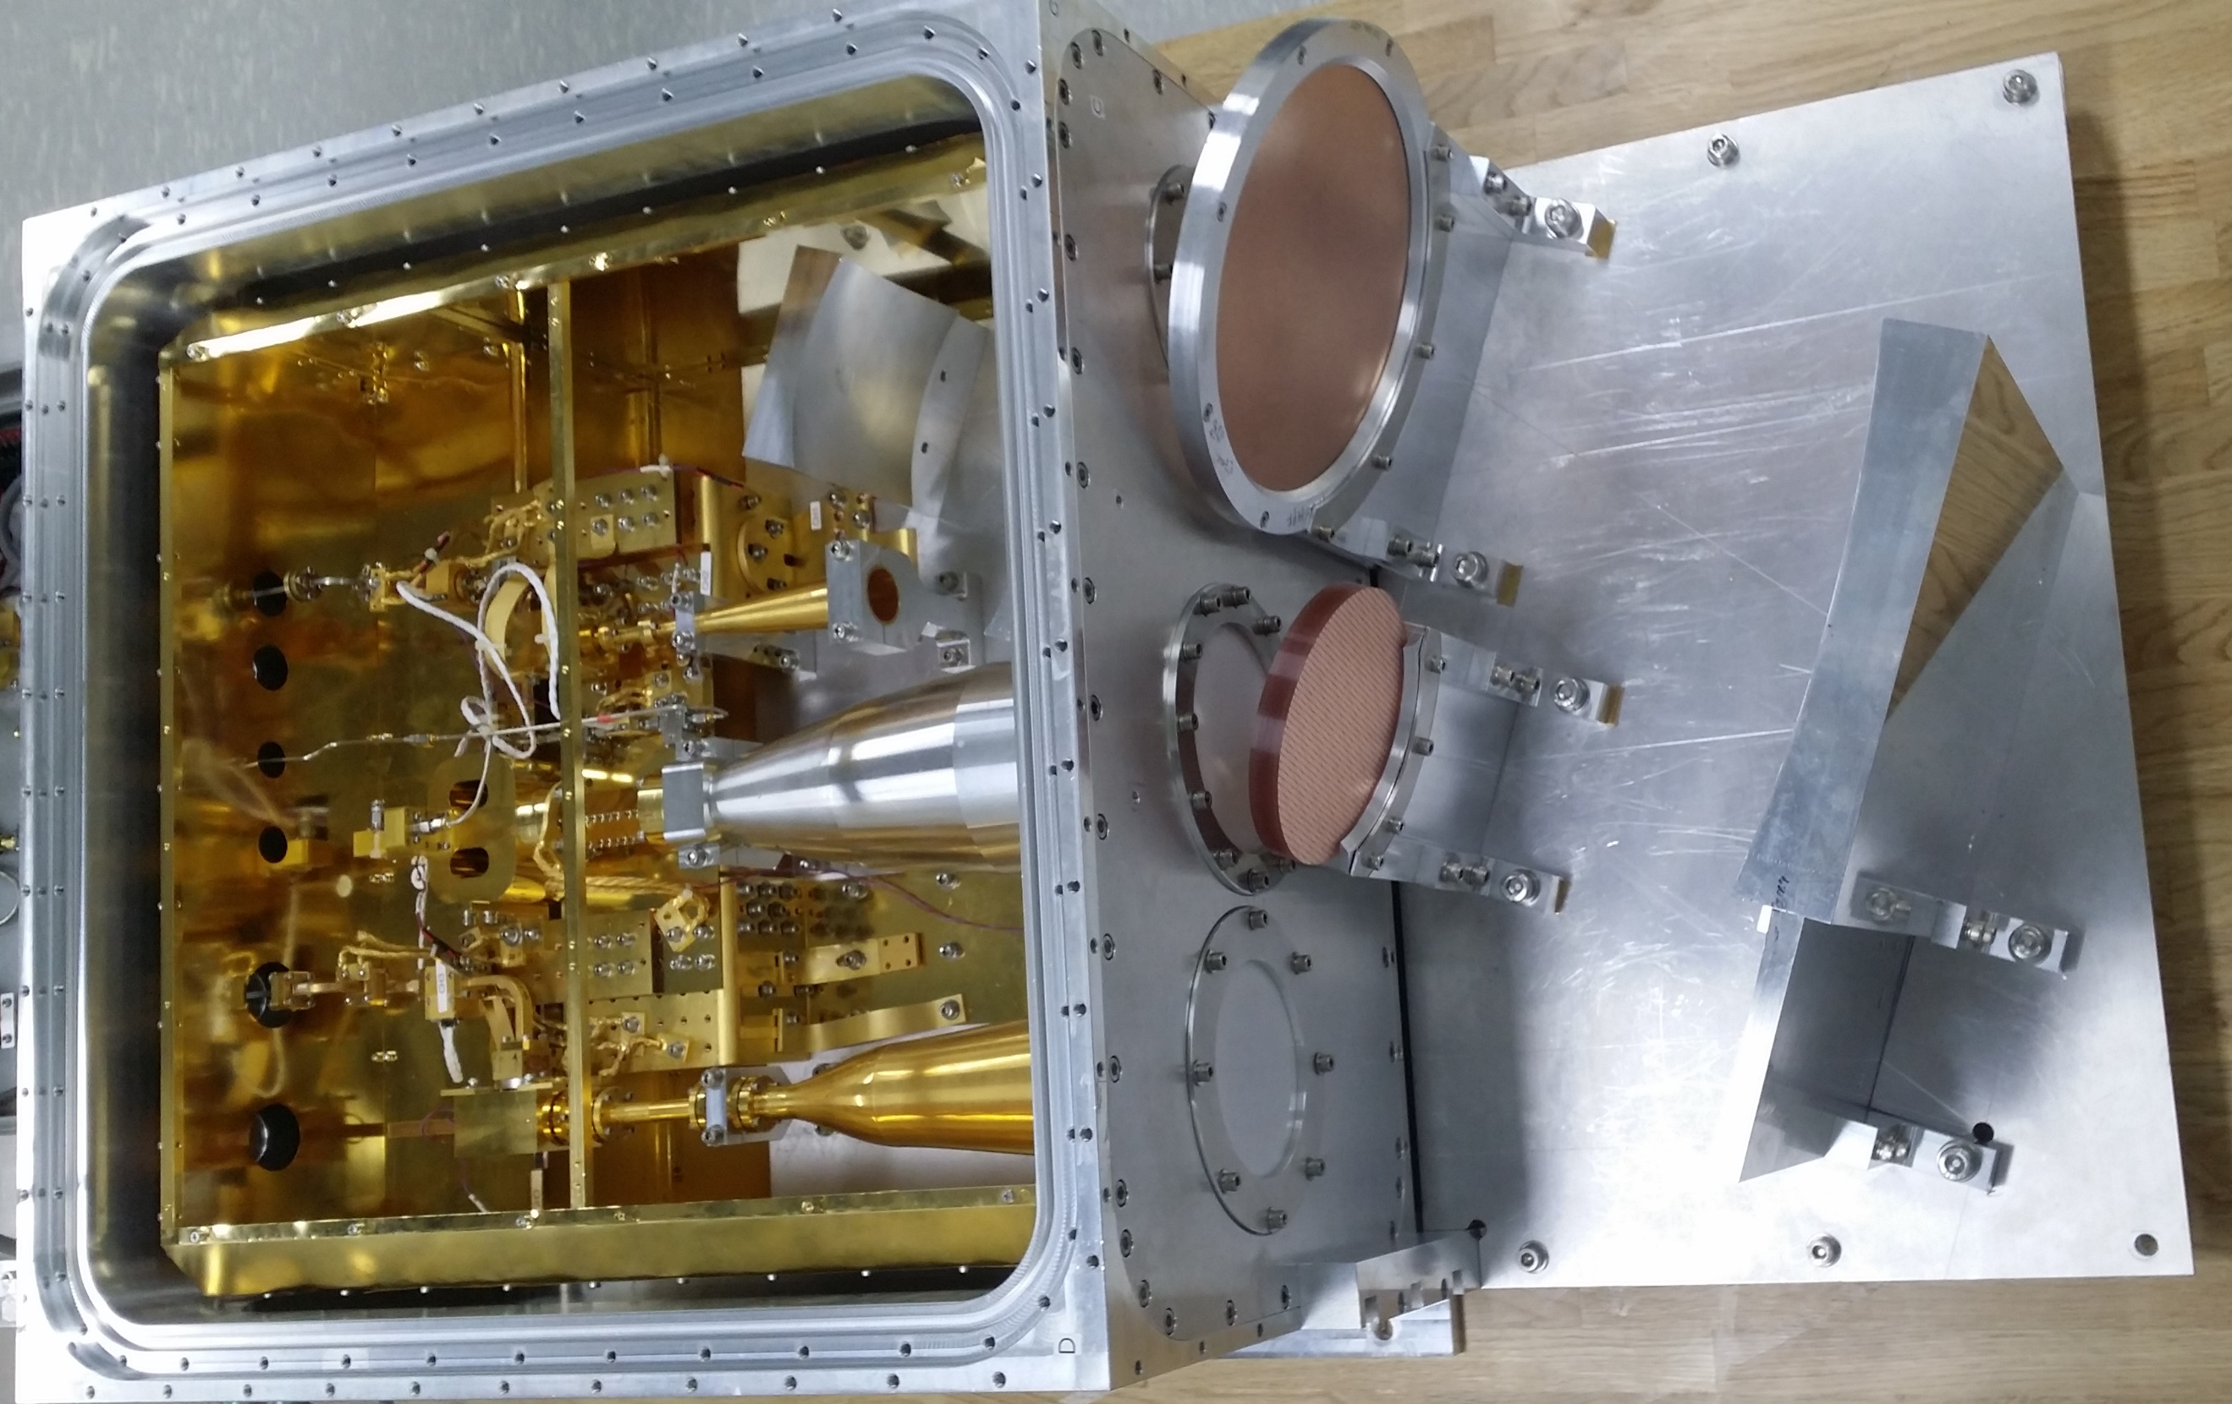
Development of CTR
HPF
Beams from antenna
W-band horn
LPF
Mirror
K-band horn
Mirror
Q-band
horn
380 mm
600 mm x 600 mm
370 mm
Observing bandwidths
IF bandwidths
Polarization
Receiver noise temperature
Operation Mode
K-band : 18~26GHz
8~16GHz
RHCP
Given next page
SSB
Q-band : 35~50GHz
LHCP
W-band : 85~116GHz

Slide 4
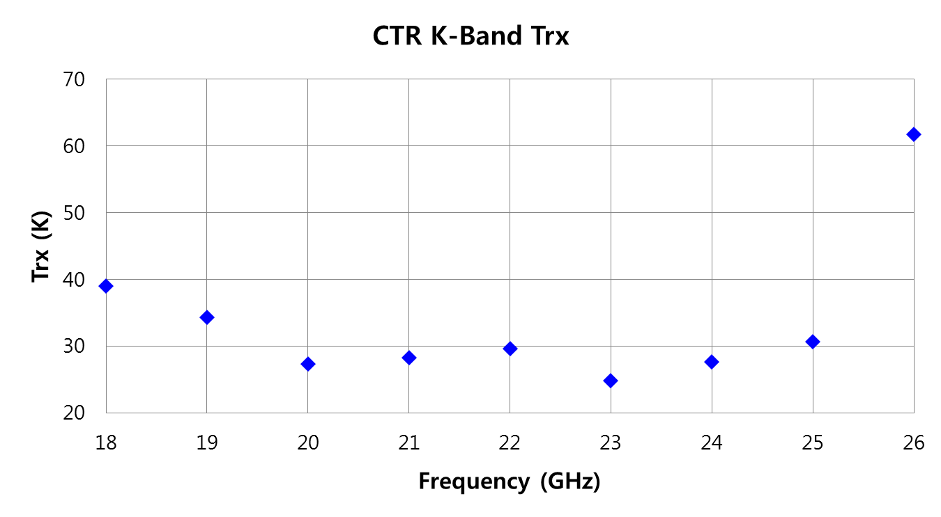
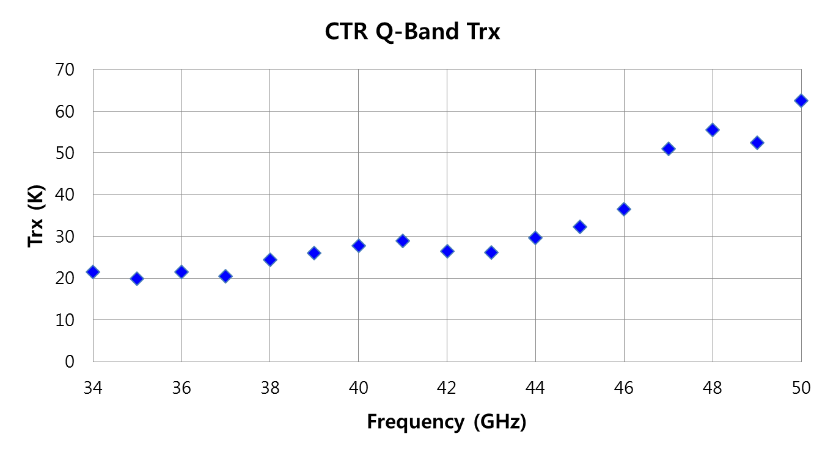
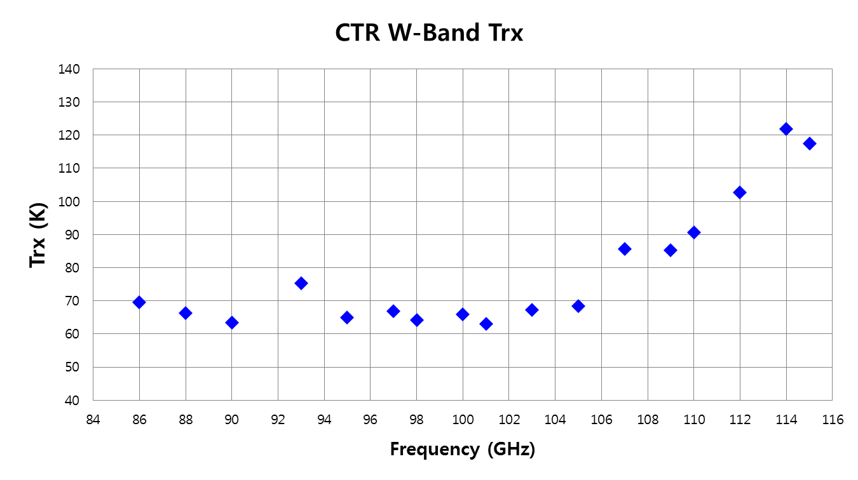
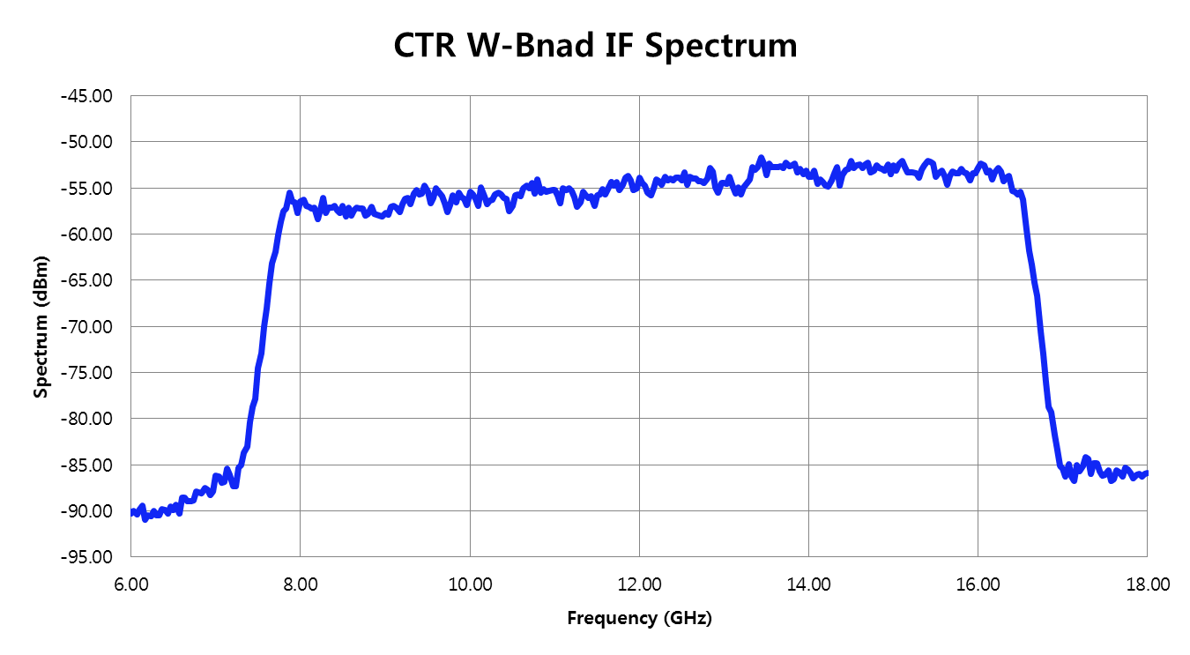
Measured receiver noise temperatures
K-band
Q-band
W-band
8 ~ 16 GHz
Goal of receiver noise temperature
- K-band : < 20 K, - Q-band : < 30K, W-band : < 60 K
Focusing on development of critical components to improve the noise temperatures
- OMT (Ortho-mode Transducer), Phase shifter (Polarizer), Coupler, Cryogenic LNAs

Slide 5
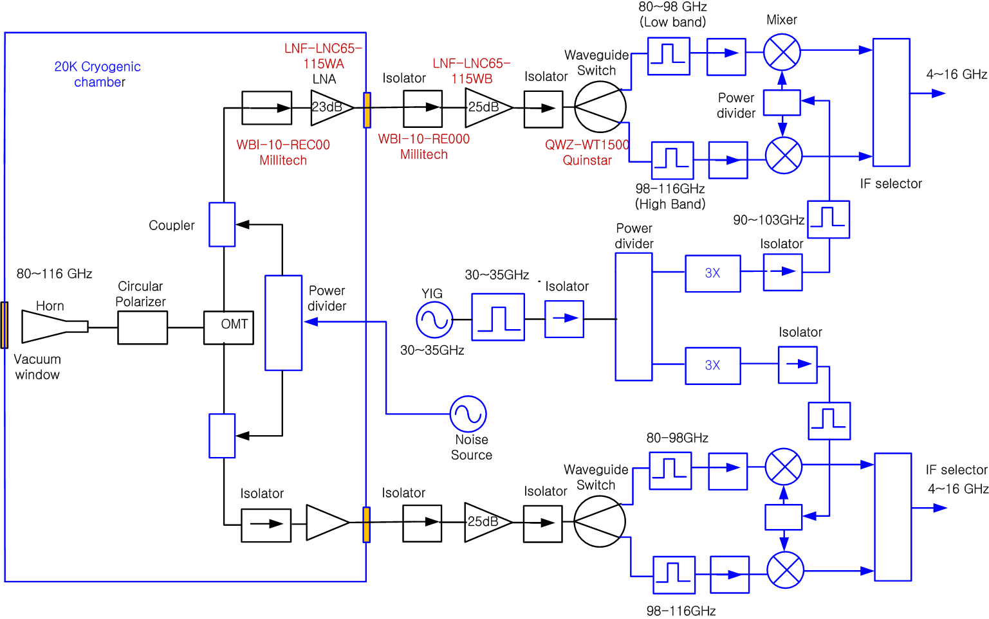
W-band Receiver Block diagram of CTR
RHCP
LHCP
The critical components in terms of noise temperature have been developing at KASI
- OMT (Ortho-mode Transducer), Phase shifter (Polarizer) and Coupler
Used LNF cryogenic low noise amplifiers for K-, Q-, and W-band
- LNF( Low Noise Factory), Sweden

Slide 6
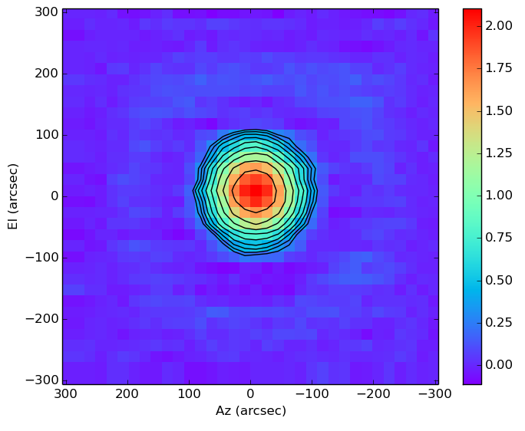
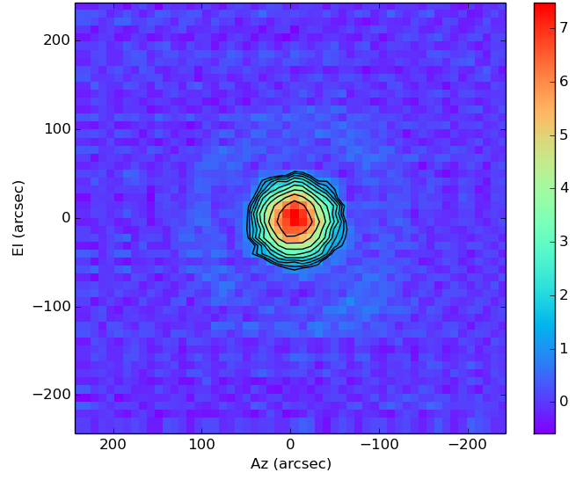
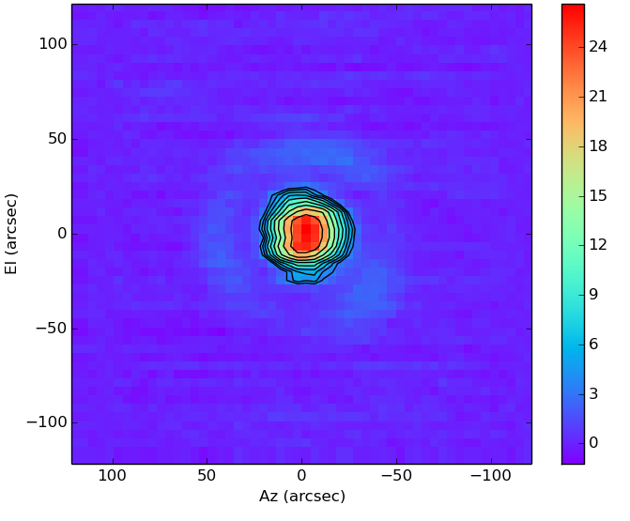
1. Beam Alignment
Test observations
Used Venus at EL = 28 degree and with 86 GHz pointing model
Pointing offsets among 3 channels : less than 3 arcsec ( ~ 1/10 of HPBW of 100 GHz)
2. Antenna Beam Patterns(1)
Mars (size = 20 arcsec) @ EL = 26
Contour = -1dB step from Peak
OTF observation method
K-band
Q-band
W-band

Slide 7
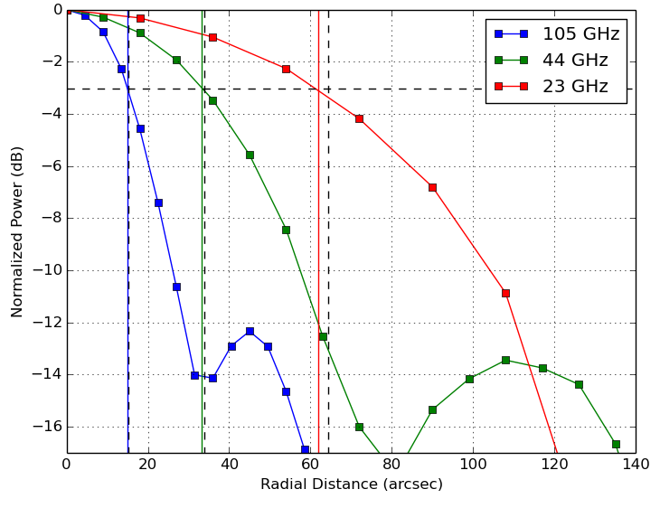
2. Antenna Beam Patterns and HPBW(2)
HPBWs of KVN Antenna
Frequency (GHz) | Measured (arcsec) | (arcsec)
105 | 28 | 28
44 | 66 | 67
23 | 123 | 128
𝛌/D
𝛌/D
Symmetric beam patterns
- Good agreement with theoretical and measured values.
- Well designed quasi-optical circuit
High side-lobe levels such 12 dB more than that of general cassegrain antenna as expected due to shaped cassegrain antenna

Slide 8
3. Aperture Efficiency (1)
Mars @ EL = 25 – 28 degree
Mars brightness Temperature (30 - 115GHz)
  http://www.lesia.obspm.fr/perso/emmanuel-lellouch/mars/
K-band | Freq (GHz) | 18.5 | 21 | 23 | 25
 | A. E.(%) | 69 | 67 | 70 | 65
Q-band | Freq (GHz) | 35.5 | 40 | 44 | 49
 | A. E. (%) | 64 | 66 | 68 | 73
W-band | Freq (GHz) | 85.5 | 95 | 105 | 110
 | A. E. (%) | 61 (53) | 49 | 47 | 44
61% at 85.5 GHz is due to mixed image signal
We obtained maximum aperture efficiency given KVN antenna properties
- Well designed quasi-optical circuit of CTR

Slide 9
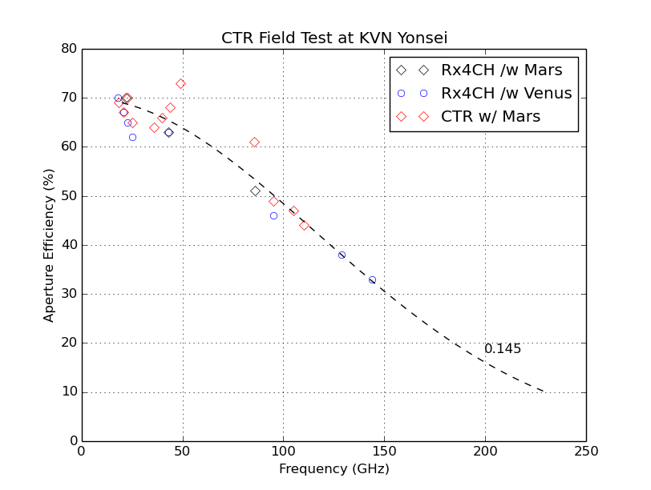
Comparison with KVN 4 channel receivers. (2)
total surface error in mm
@ EL = 27
We obtained maximum aperture efficiency given KVN antenna properties
- Total surface rms with 145 micrometer of KVN antenna

Slide 10
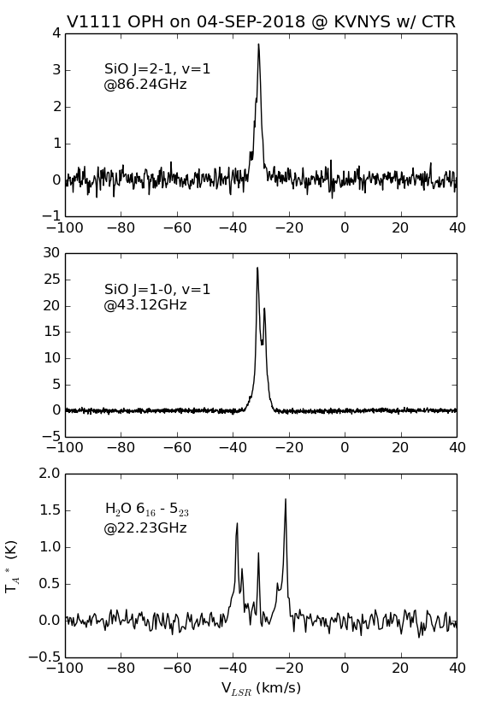
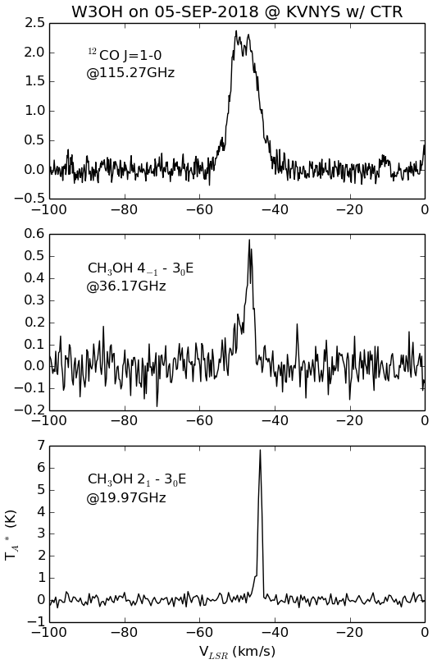
Simultaneous observation results(1)
86.24GHz
115.27 GHz
43.12 GHz
36.17 GHz
22.23 GHz
19.97 GHz

Slide 11
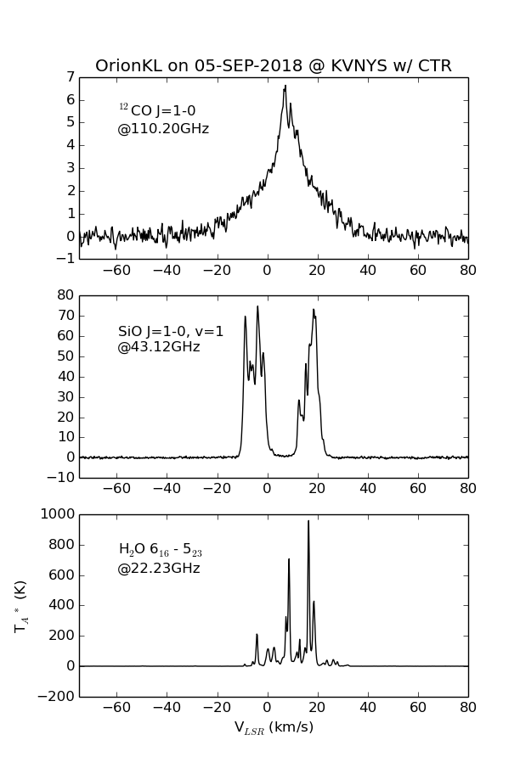
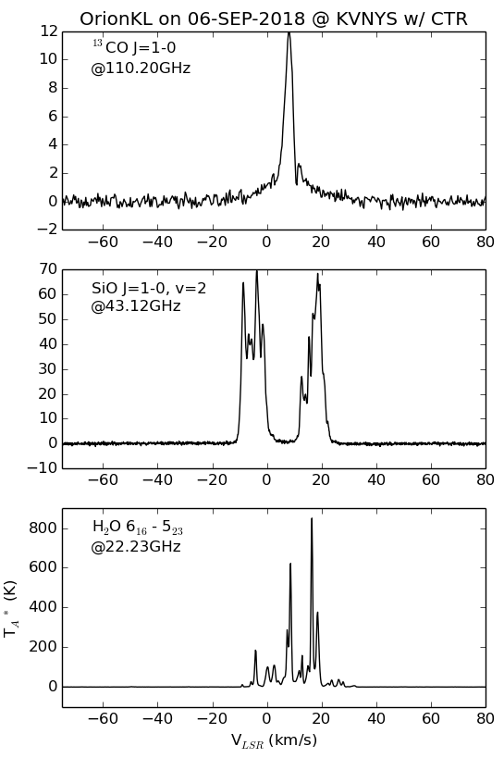
Simultaneous observation result (2)
115.27GHz
110.20GHz
43.12 GHz
43.12 GHz
22.23 GHz
22.23 GHz

Slide 12
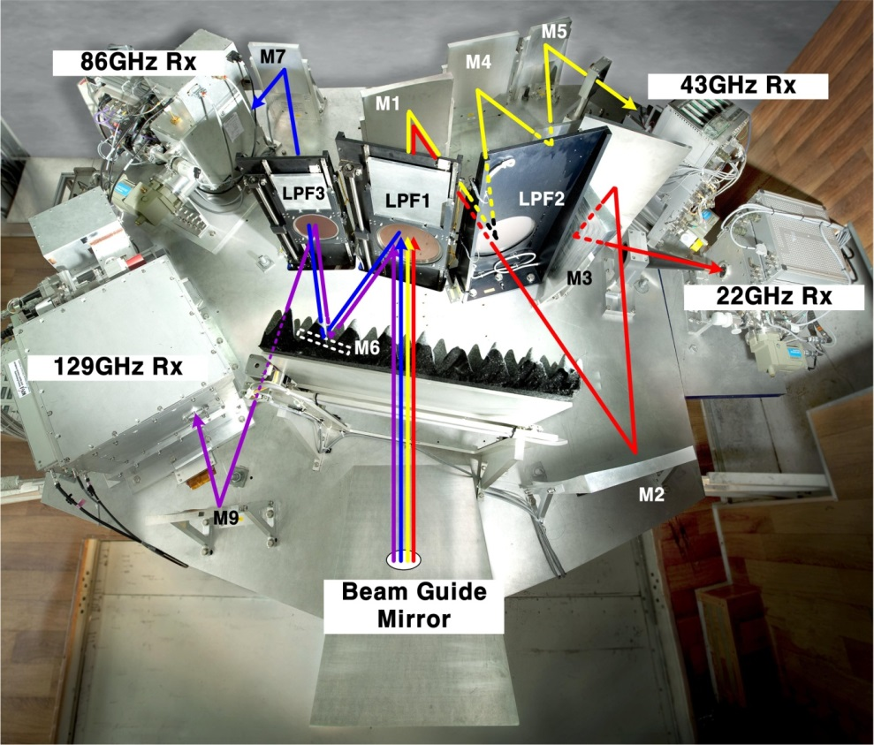
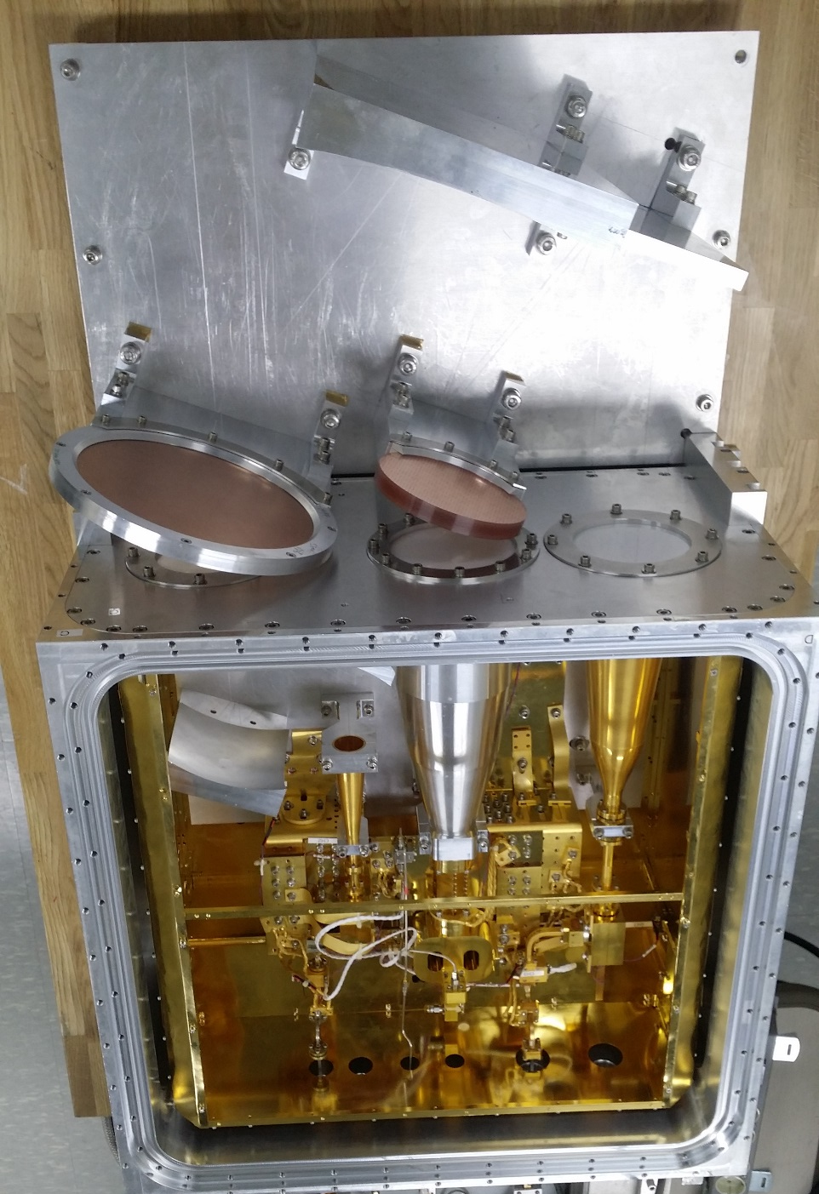
Summary
2300 mm
2600 mm
Current KVN receiver optics
600 x 980 x 370 mm
Pointing offset among 3 channels : less than 3 arcsec to conduct simultaneous observations
Aperture efficiencies : Obtained as much as we could (K- : 68 %, Q-: 66 %, W-band : 50%)
Receiver noise temperatures : Not bad, but have to be improved (OMT, Polarizer and LNA)
CTR is tailorable for use in telescopes with a small receiver cabin.
Ultimately this concept may lead to development of much more compact multi-frequency receiver systems for mm-wave and sub-mm radio telescopes

Slide 13



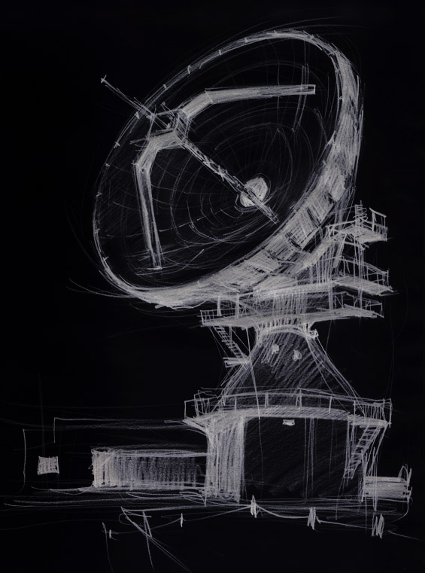


Not only I am very much proud of my colleagues
and their achievements,
But also I would like to really appreciate for their efforts
and passions for KVN
Thanks for your attention

